Slide 1
Indeed Web Crawler
Brandon Nguyen\Peter Do\Anthony Lynch

Slide 2


Website: Indeed
Job Posting website:
Interact with Employers
Career Guides
Information on Companies
Our Project:
Scrape IT job posting information within a certain radius of Boston, MA

Slide 3
WebCrawling Code

Slide 4
BluePrint: 3 classes
Add the image of the code here
Class: get_url
Gets Indeed’s URL
Class: main
Uses get_url and get_card to store to DB
Parameters:
Position
location
Class: get_record
Gets job information

Slide 5
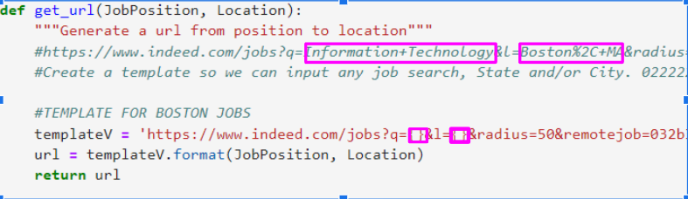
get_url()
Gets Indeed’s URL with custom job position and location

Slide 6
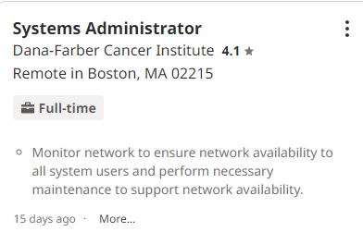
Get_record()
8 information pieces:
Job title
Company name
Rating
Location
Summary
Posted Date
Date today (using datetime)
Compensation

Slide 7





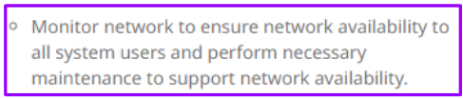
get_record() (cont.)
Store information into tuple: record
Record
8 job info pieces

Slide 8
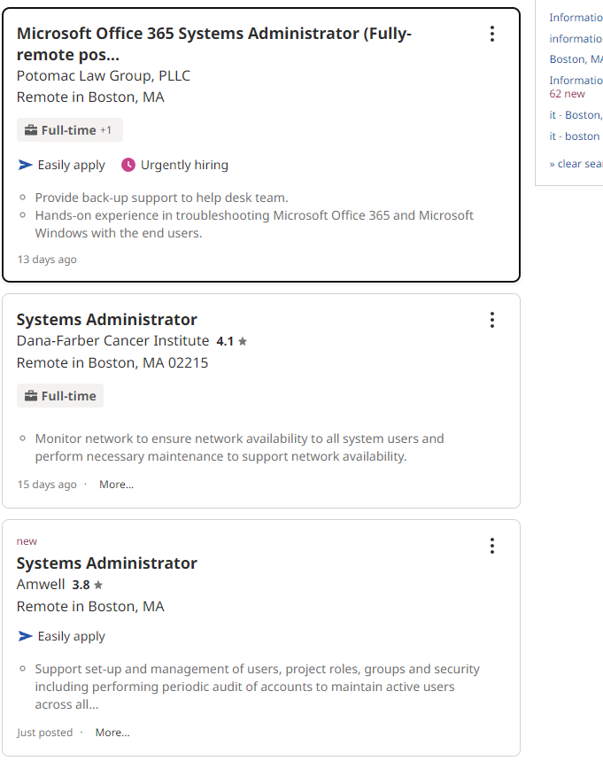
main()
3x Job cards
Each job posting in one box (card)
1 page = 15 cards
Job card

Slide 9
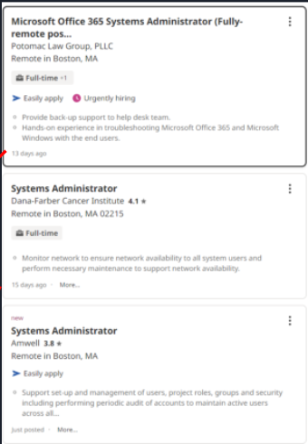

Main() Process
Job posting(card) -> extract info to make record-> store all record into list(records)-> put into Database
records
Indeeds
Table: jobtable2
Card 1
record 1
-jobtitle
-company
……
Card 2
record 2
-jobtitle
-company
……
Card 3
record 3
-jobtitle
-company
……

Slide 10
Descriptive Analysis

Slide 11
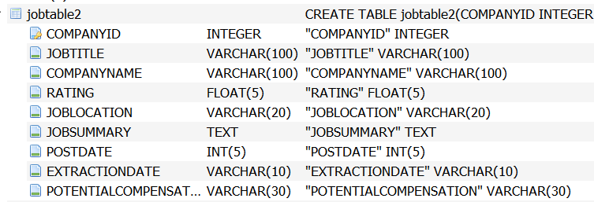
Database
Database:
Indeeds
9 Total columns in Table “jobtable2”:
COMPANYID (Primary Key)
JOBTITLE
COMPANYNAME
RATING
JOBLOCATION
JOBSUMMARY
POSTDATE
EXTRACTIONDATE
POTENTIALCOMPENSATION

Slide 12
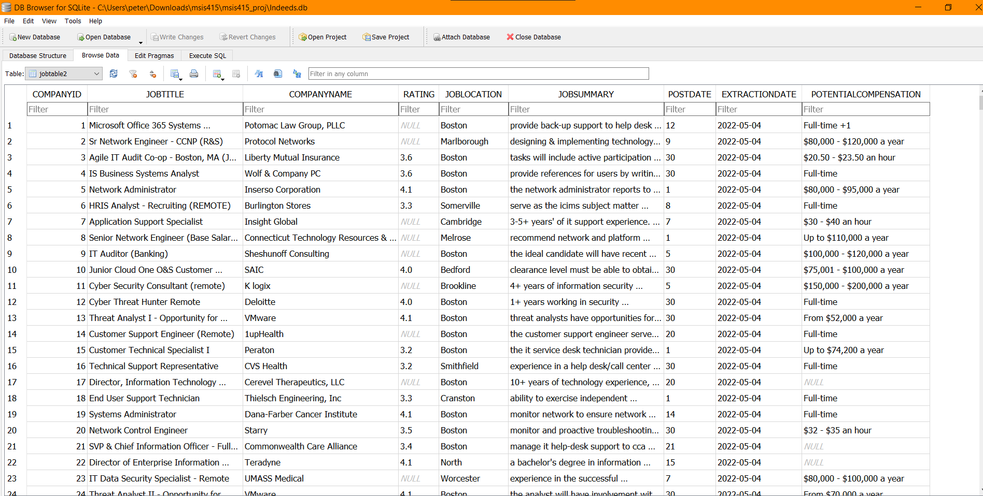
DataBase
This is the database that resulted from our Web Crawler, using the data we separated each data field into its own column to make it more distinguishable for viewers.

Slide 13
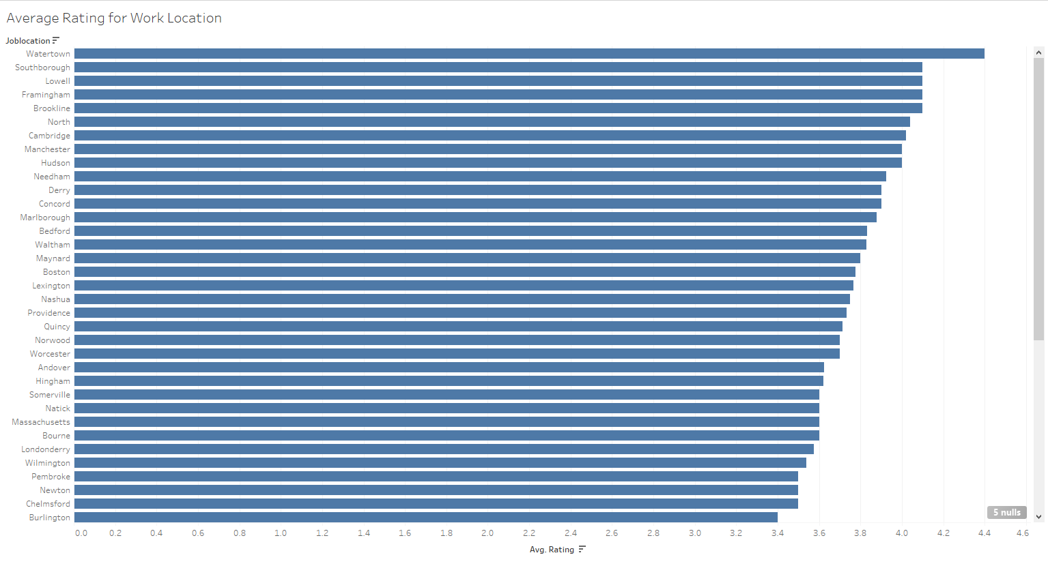
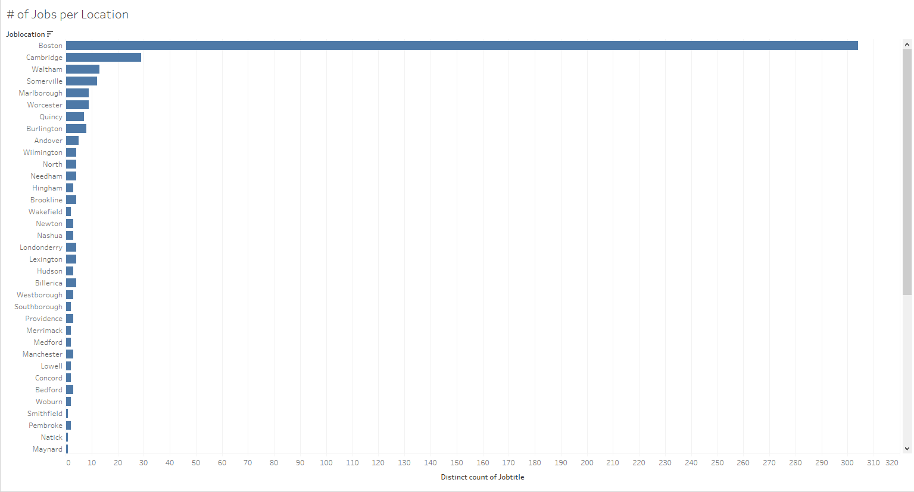
Analysis 1
We decided one good analysis we could do was to see how locations differed based on their average ratings for their job listings. We also wanted to make sure to understand their ratings alongside the number of job listings for each area.
Table created using Tableau comparing job location (x-axis), and review rating (x-axis)
Table created using Tableau, job locating on (y-axis), number of job listings (x-axis)

Slide 14
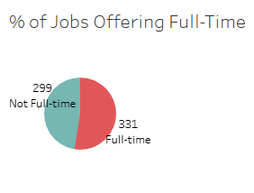
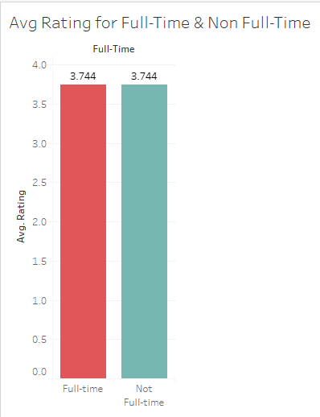
Analysis 2
Pie chart illustrating the number of full time job offers compared to part-time offers.
For our second analysis we decided to see how many job listings were offering full-time positions/salaries, and from that determine whether the full-time positions had a better average rating.
The average rating for a full-time job listing, and a non full-time job listing

Slide 15
(NLTK) Natural Language Toolkit
Focus: POS tagging & Frequency distribution

Slide 16
Frequently used Terms.
Nltk
Tokenization
Frequency Distribution
Bigrams
Trigrams

Slide 17
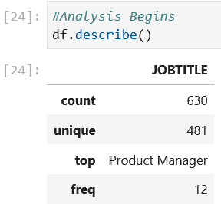
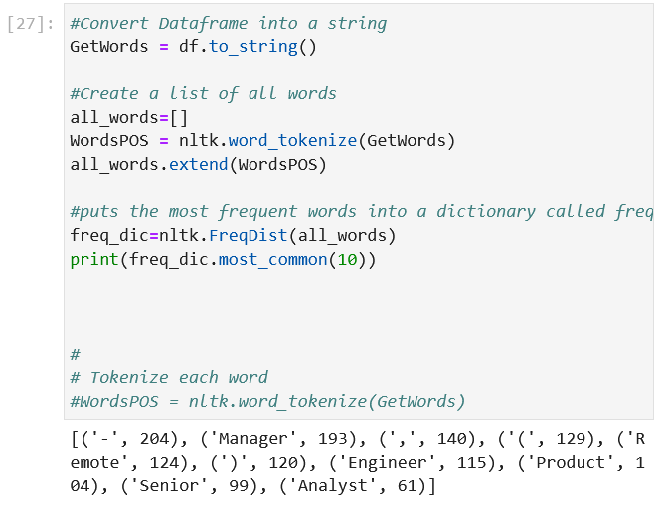
Analysis 3
We focused on JOBTITLE by selecting the column from the database tokenizing each word, then found the most occurred.

Slide 18
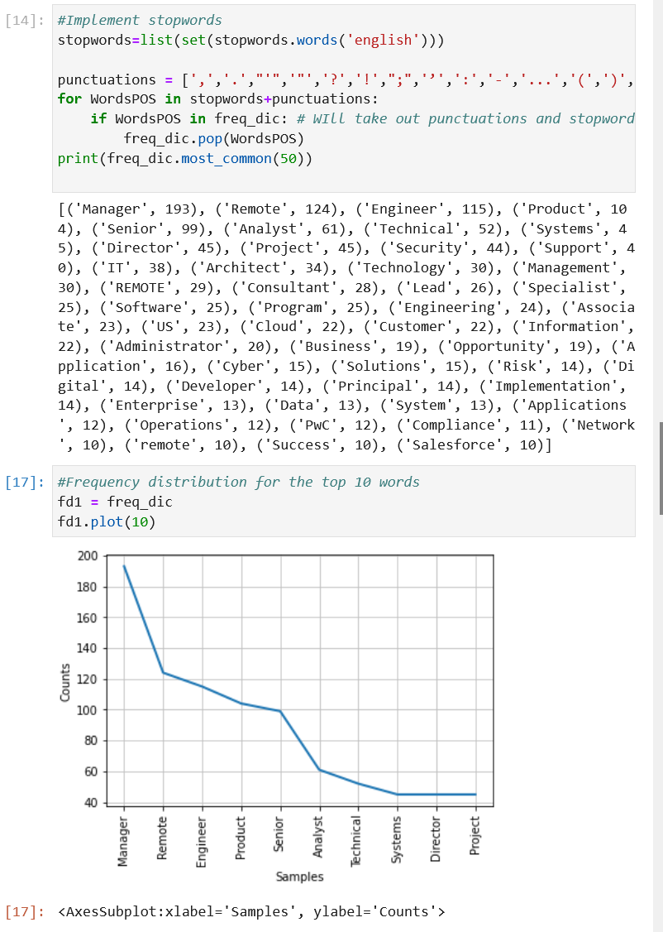
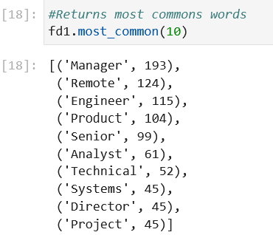
Analysis 3
Next, we implemented stopwords which filtered out common symbols and common words such as pronouns or articles; ‘a’, ‘the’, ‘me’, ‘i’

Slide 19
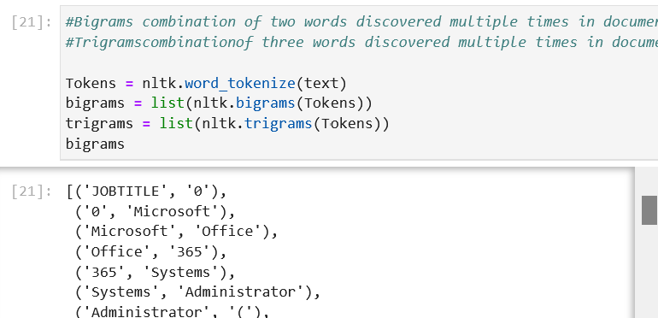
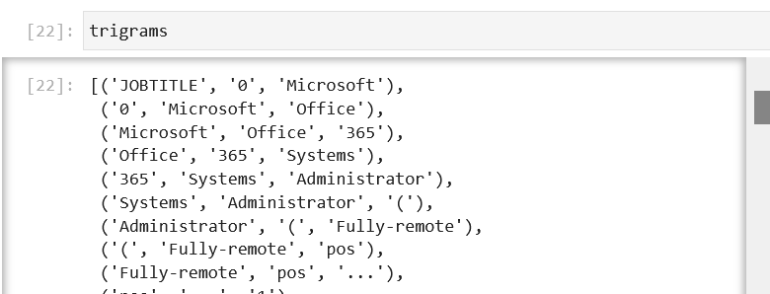
Analysis 4
Bigrams: a pair of consecutive written units such as letters, syllables, or words.
Trigram: a group of three consecutive written units such as letters, syllables, or words.

Slide 20
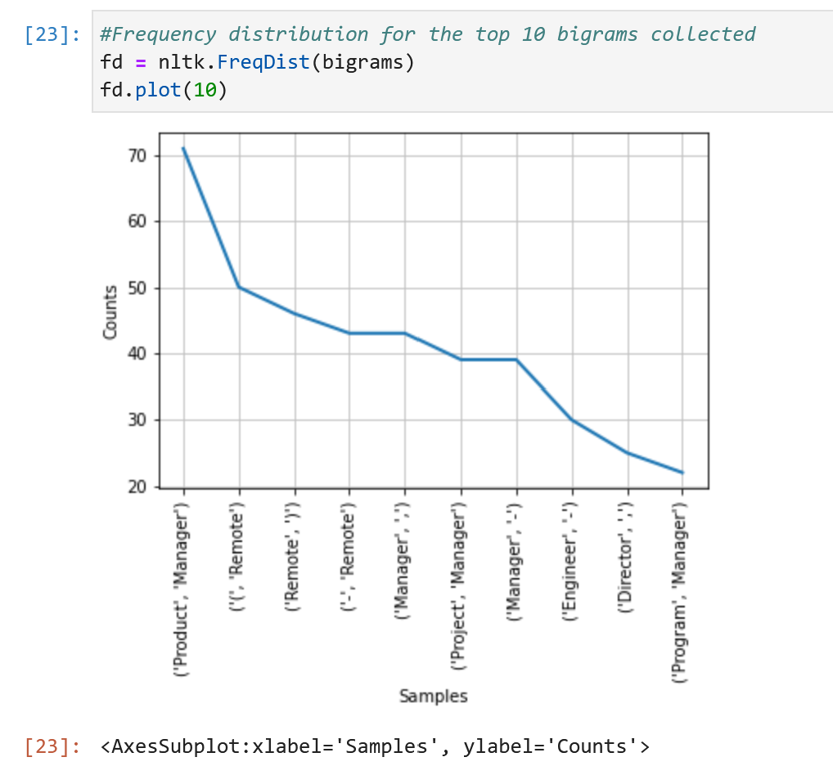
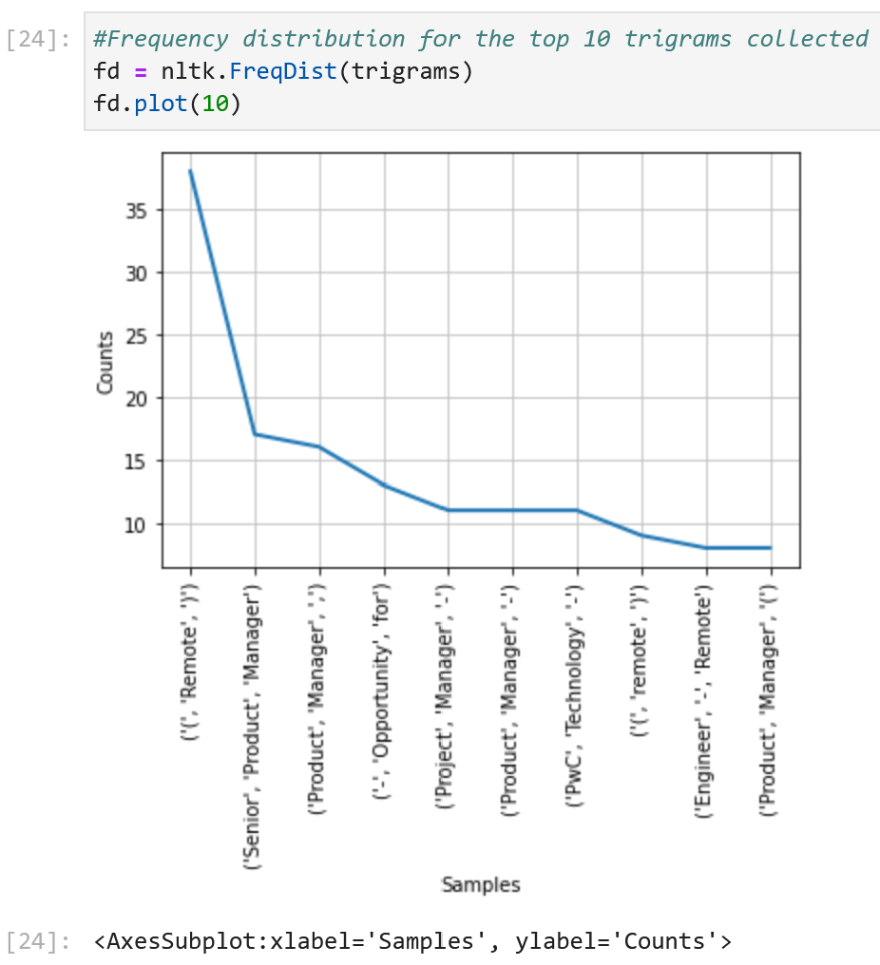
Analysis 4
Converted these values into a visual representation through frequency distribution.

Slide 21
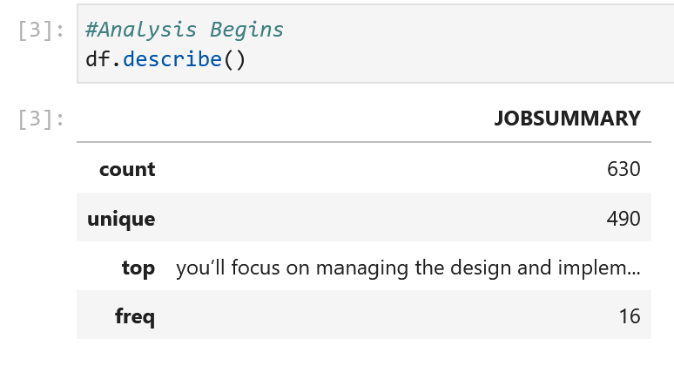
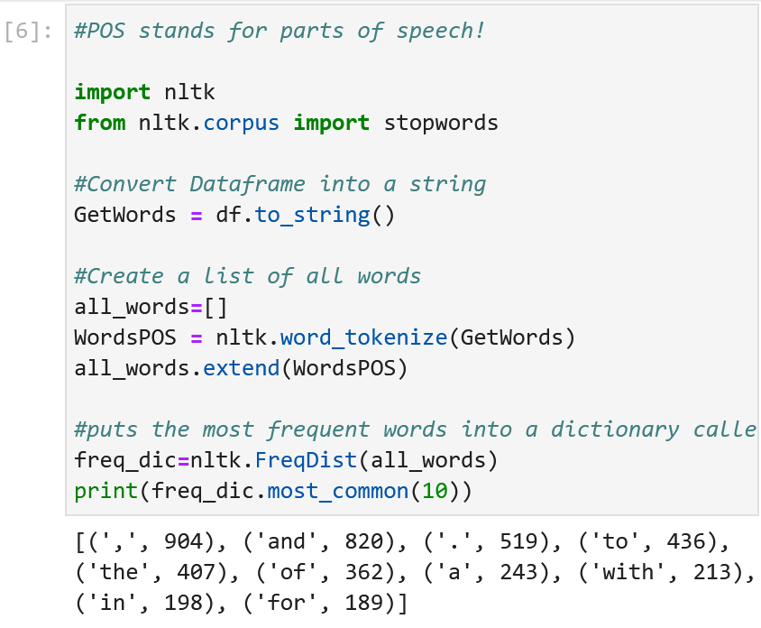
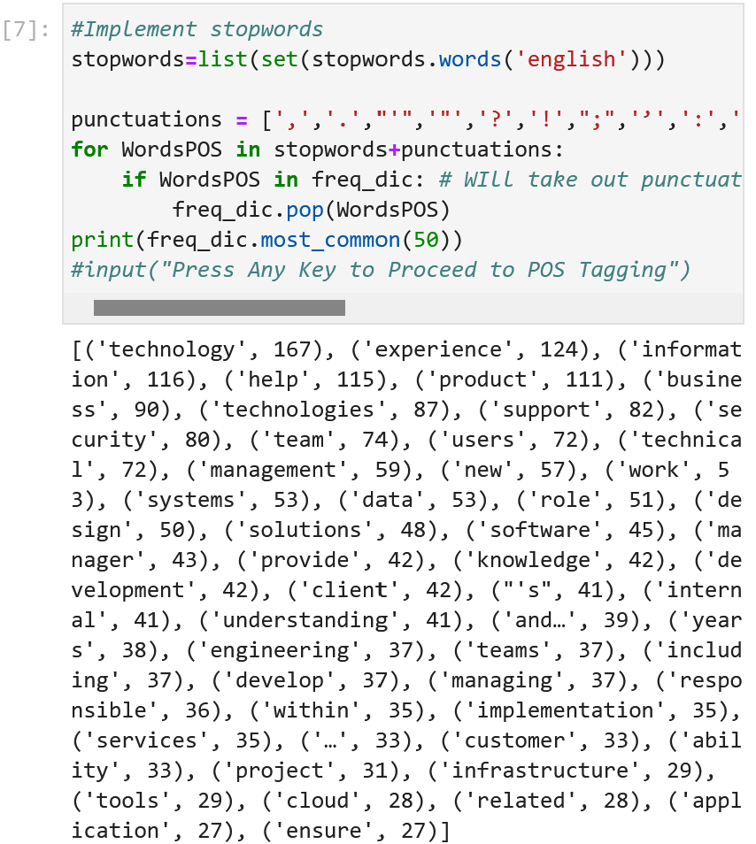
Analysis 5
Started on a new focus column in the database; JOBSUMMARY, a column that shows the contents of a job.
Tokenize using nltk, implemented a stopwords then returned the most common words located only in the job summary column.

Slide 22
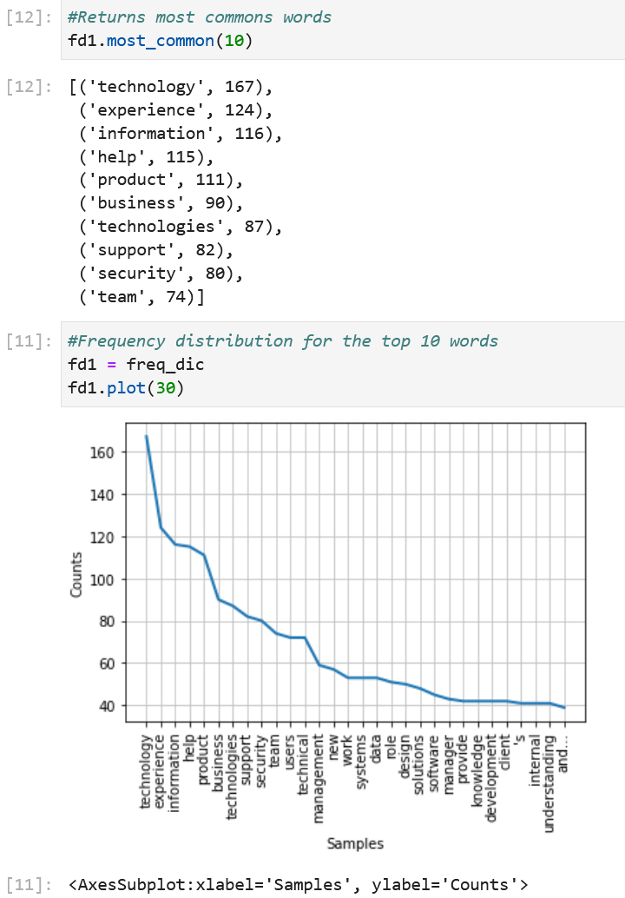
Analysis 5
With this we created a frequency distribution chart to display a visual of our results.

Slide 23
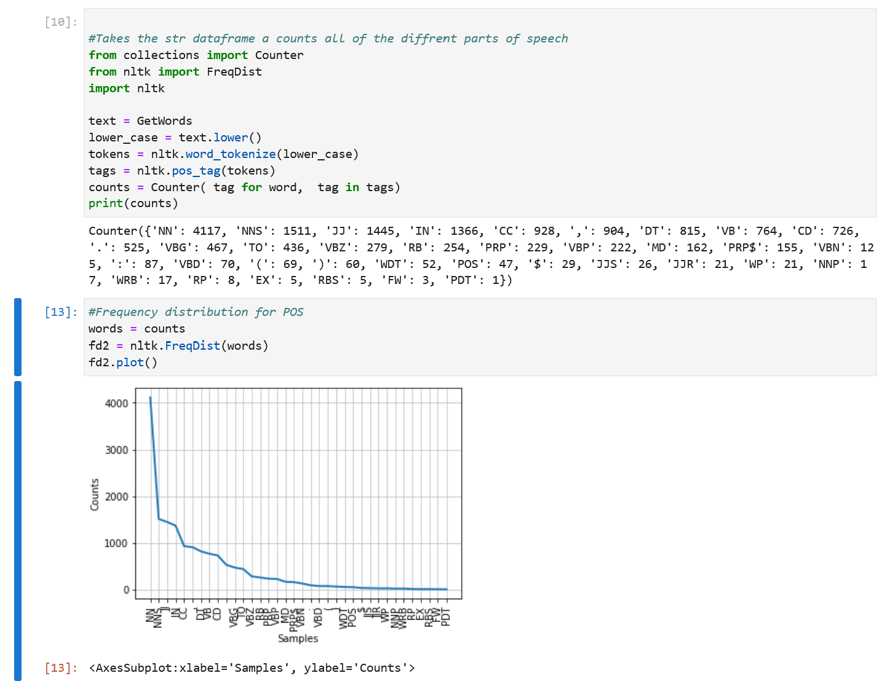
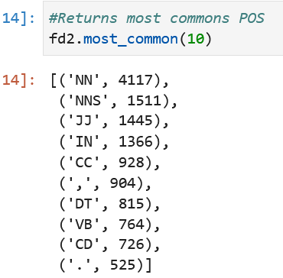
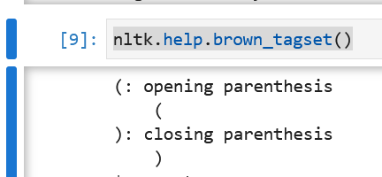
Analysis 6
Next we created some code to count how many different parts of speech their are located in job summary then used frequency distribution to plot and visualize our findings.
Use nltk.help.brown_tagset() to find out what each one means
EX. NN = noun

Slide 24
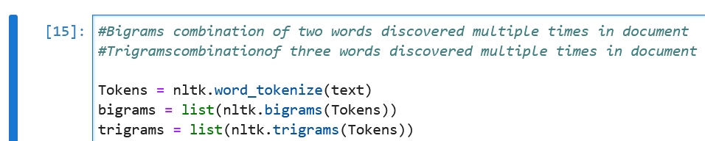
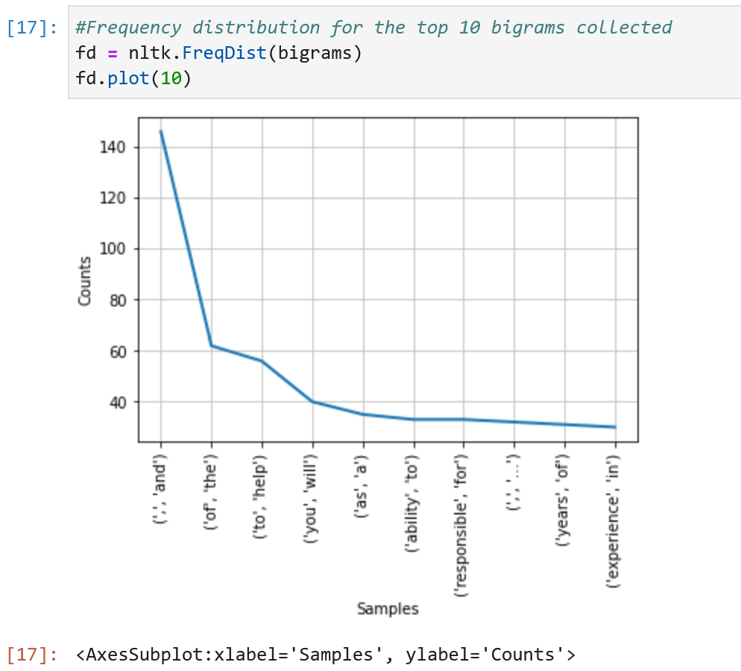
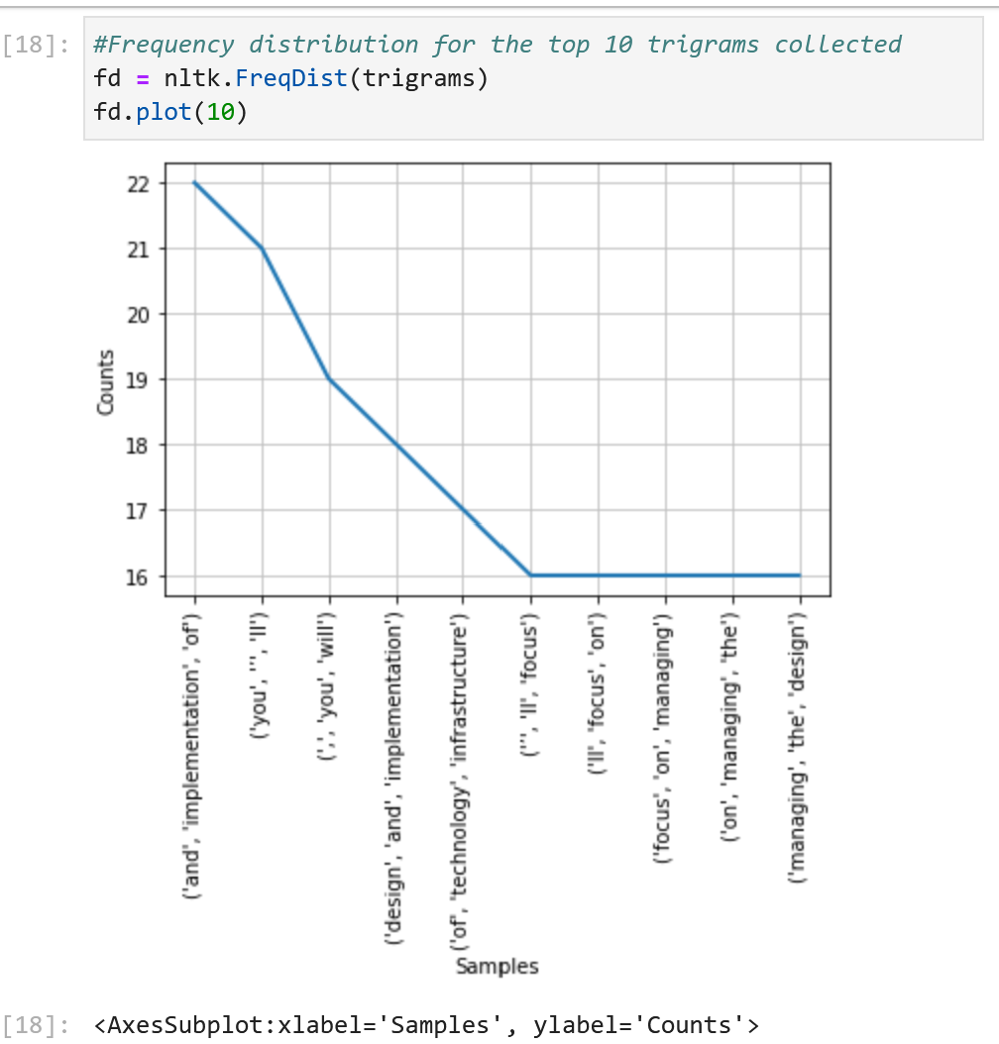
Analysis 7
Lastly, we created some bigrams and trigrams frequency distribution graphs to visualize which groups of 2 or 3 words are most commonly used based on our search criteria.

Slide 25
Conclusion and Challenges
Conclusion:
Learn the what skills are in high demand
Know what companies seem favorable and ones to be cautious of via ratings and compensation
Help employers improve company
Know what locations have high job opportunities
Challenges:
Ratings measure overall company, not just IT -> contain feedback from other departments, which might give accurate experience for those solely in IT
Indeed compensation tags were inconsistent (example : range of salary, hourly rate, full time, contract, etc) -> hard to do analytics on this field

Slide 26


